Slide 1

Organization Visit:
wedevs
Course Name: Business Studies for Engineers
Course Code: BUS 405
Supervised by-
Md. Iftekharul Amin
Assistant Professor
Institute of Business Administration
University Of Dhaka

Slide 2
Presented by
Group 5
0816. Imam Hossain Kawser
0817. Atiq Ahammed
0818. Hasan Tarek

Slide 3
Presentation outline
Aim of the visit
About the Organization
Office Description
Hierarchical Structure
Recruitment System
Culture of Organization
Employee Termination

Slide 4
Aim of the visit
To study the organizational culture
Know about the structure of an organization
Get an idea about the relationship between manager and employees
Know about environment of an organization

Slide 5

About the organization: wedevs
WordPress based product company
Passionate about source code development
Start journey in Bangladesh in May 2012
Global perspective : Polycentric attribute
Business policy : Exporting

Slide 6
Mission & Vision: wedevs
Mission:
Provide with the most reliable, workable and effective WordPress solution
Customer satisfaction is the priority
Client success is the win
Vision:
To become the most customer-focused International WordPress solutions provider

Slide 7
Unit of the organization: wedevs
wedevs has 7 fundamental units:
Business Development
Support
Software Development
Design & Frontend
Sales & Market
HR & Accounting
Control Development

Slide 8
Office Description
Location:
Level-3, House - 1005,
Avenue - 11, Road - 09,
Mirpur DOHS,
Dhaka 1216.

Slide 9
Managerial Hierarchy
Chairman
Managing Director
CEO
CTO
COO

Slide 10
Managerial Hierarchy
CEO
Head of Content
Head of Business
Head of Sales/
Marketing

Slide 11
Managerial Hierarchy
CTO
Head of Design & Frontend
Lead developer
(Project manager)
Lead Developer
(Dokan)
Lead Developer
(ERP)

Slide 12
Managerial Hierarchy
COO
Head of Support
Head of HR
Head of Accounts

Slide 13
Recruitment System
Screening
Make an offer
Phone Interview
Face to Face Interview
Written Examination
Practical Project

Slide 14
Orienting New Employees
All new employees must go through a three months training to cope with the organization’s working environment
Current employees of the department are encouraged to hold informal workplace related discussions with new employees on topics such as goal, vision and history of the company

Slide 15
Culture Of The Organization
View of management: Omnipotent
Expressing gratitude for work done is highly encouraged
Credit and ownership is always given to innovative ideas

Slide 16
Culture Of The Organization
Employees with innovative ideas are assigned leading roles in transforming their ideas into reality
All tasks must be approved by immediate line manager
Employees with significant contribution to the organization are awarded Chairman’s Award.

Slide 17
Culture Of The Organization
Customers are directly communicate with support team
Policies are employee oriented
Technological changes are adopted
Long term plan oriented

Slide 18
Culture Of The Organization
Employee performance is evaluated quantitatively using PMP after 4-6 months
All permanent employees no matter where they stand in the organizational hierarchy can contribute to the company’s strategic decisions
Policies have been known to change based on feedback collected from employees

Slide 19
Informal Culture
Many employees have their own workplace nicknames
Birthdays are celebrated by cutting cakes and giving cards both of which are sponsored by the employee’s immediate in line manager
Weekly/bi weekly a party is held on Saturday

Slide 20
Employee Termination
Employees can quit their work, be terminated from work or be dismissed
Employees are dismissed if and only if they are known to have made a significant mistake
If any employee wants to quit, he/she must inform the senior at least 1 month before
Dismissed or self-quit employees get 1 month’s extra payment

Slide 21

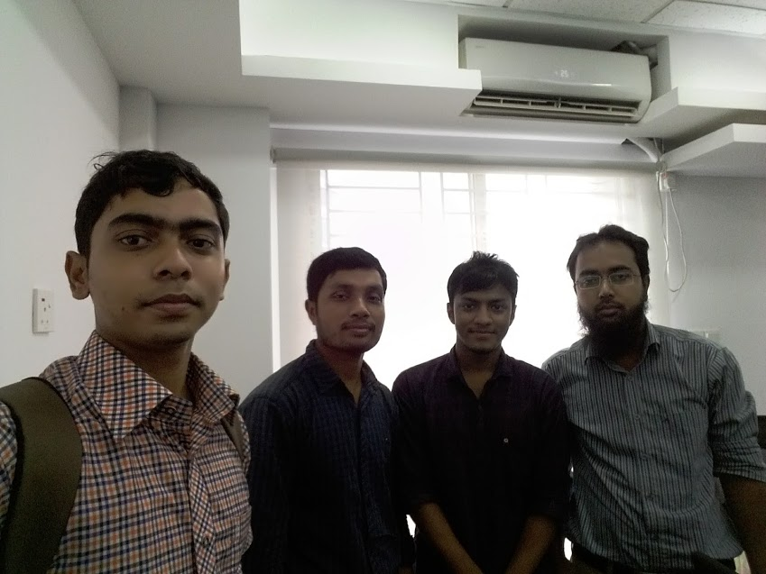
Memories
With Nizam Uddin, COO of wedevs

Slide 22
Thank You

